Slide 2
Blazor vs JavaScript Frontend Frameworks
Thien Nguyen

Slide 3
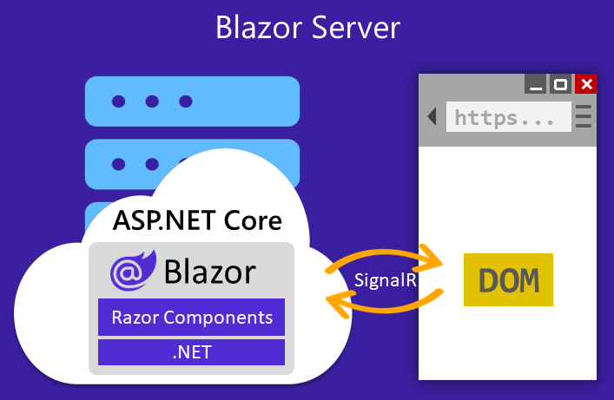
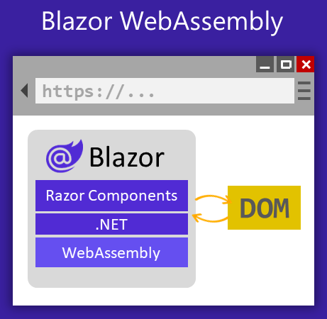
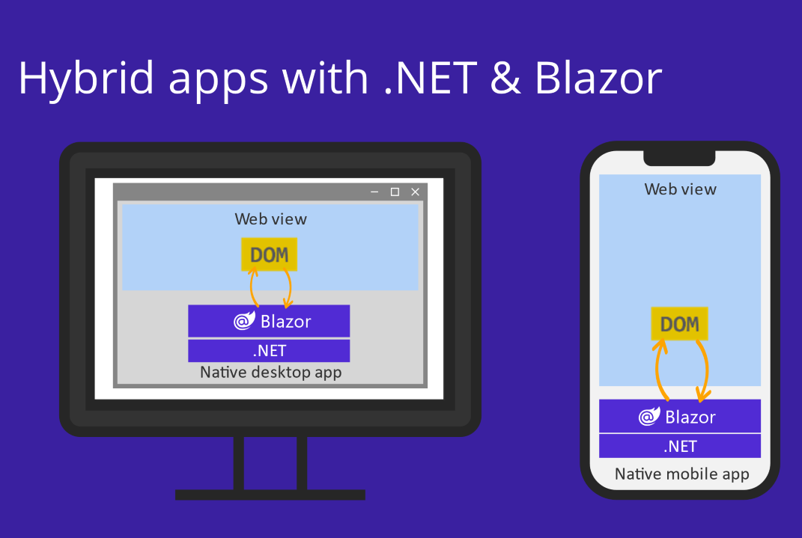




Review Blazor’s Hosting models
Static Server-side Rendering (SSR)
.NET 8
https://...
HTTP
HTML
DOM

Slide 4



.NET 3-8+
.NET 8+
Server /
WebAssembly
Static SSR
MyWebApp
MyWebApp
Home
Home
Profile
Profile
Chat
Chat
WebAssembly
Admin
Admin
UserList
UserList
Server
Content
Content
NEW
Global interactivity
Per page/component interactivity

Slide 5
Blazor – Render modes
Name | Description | Render location | Interactive
Static | Static server rendering | Server | NO
Interactive Server | Interactive server rendering using Blazor Server | Server | YES
Interactive WebAssembly | Interactive client rendering using Blazor WebAssembly | Client | YES
Interactive Auto | Interactive client rendering using Blazor Server initially and then WebAssembly on subsequent visits after the Blazor bundle is downloaded | Server, then Client | YES
Prerendering is enabled by default for interactive components

Slide 6
Demo

Slide 7
Static server-side rendering
Streaming
Enhanced Navigation
Faster page loads with fewer HTTP requests
Retain most DOM elements
Forms handling
How it work https://github.com/dotnet/aspnetcore/blob/main/src/Components/Web.JS/src/Services/NavigationEnhancement.ts

Slide 8
Full stack web UI with Blazor
Server
Server & Client
Client
Static server rendering
Enhanced navigation & form handling
Streaming rendering
Enable interactivity per component or page
Auto select the render mode at runtime

Slide 9
Blazor vs MVC or Razor Pages
Blazor
MVC or Razor Pages
Component model
Many hosting models
Many rendering mode
Rich features: streaming rendering, enhanced navigation
Youngest
SSR only
MVC
Oldest, migrated from traditional ASP.NET MVC.
Separate Views and Controllers, The views can be switchable at run time (Theming)
Razor Pages
A lightweight approach for SSR aim to be simpler (page-focused) and more productive than MVC

Slide 10
Blazor vs Next.js
Blazor
Next.js
C#
Not mature enough
Small community and ecosystem
Share code between client and server (.NET)
Static site generation is considering for the next version
JavaScript/TypeScript
Matured
Big community and rich ecosystem
Share code between client and server is not common
Static site generation

Slide 11
My conclusion
Frontend JavaScript framework is much mature and have rich ecosystem than Blazor
Blazor has it own market such as LoB applications.
Blazor has more benefits when the backend is .NET
Blazor server maintain the state, the logic and the code of each client on the server, it is very good for some highly secured applications like gaming
https://builtonblazor.net/

Slide 12

Thanks for joining!
https://www.facebook.com/devcafevn
https://www.youtube.com/c/devcafevn

